Slide 1
Object-Oriented Software Engineering
Practical Software Development using UML and Java
Review of Object Orientation
Part 1

Slide 2
Objective
In this chapter you will learn about the following
    The basic principles of object orientation.
    Classes and objects.
    Methods, operations and polymorphism.
    Organizing classes into inheritance hierarchies.
Chapter 2: Review of Object Orientation

Slide 3
2.1 What is Object Orientation?
  Object-oriented systems make use of abstraction in order
  to help make software less complex.
  Object-oriented systems combine procedural abstraction with data abstraction.
    procedural abstraction hides the details of how a task is completed from the user, while data abstraction hides the details of what data is being used from the user.
Chapter 2: Review of Object Orientation

Slide 4
Procedural abstraction and the procedural paradigm
  Earliest days of programming, software has been organized around the notion of procedures. These provide procedural abstraction.
    The entire system is organized into a set of procedures. One ‘main’ procedure calls several other procedures, which in turn call others.
  Works very well when the main purpose of programs is to perform calculations with relatively simple data.
    Systems written using the procedural paradigm are complex if each procedure works with many types of data, or if each type of data has many different procedures that access and modify it.
Chapter 2: Review of Object Orientation

Slide 5
Data Abstraction
Data Abstraction – reduce system complexity.
    Structures - data abstractions
    Group together the pieces of data that describe some entity, so that programmers can manipulate that data as a unit.
      even when using data abstraction, programmers still have to write complex code in many different places.
    for example, a banking system that is written using the procedural paradigm, but using records/Structures representing bank accounts.
    Software has to manage accounts of different types, such as checking, savings and mortgage accounts
      Each type of account will have different rules for the computation of fees, interest, etc.
Chapter 2: Review of Object Orientation

Slide 6
Data Abstraction
Such a system would have procedures like the following pseudocode in many different places:
if account is of type checking then
do something
else if account is of type savings then
do something else
else
do yet another thing
endif
Imagine that clients can hold several accounts of different types, and some
accounts can be held jointly; also the different account holders might have
different rights. Rules to deal with issues like these would be scattered
throughout the code, making change very difficult.
Chapter 2: Review of Object Orientation

Slide 7
The object-oriented paradigm
  Programmers began to see the advantage of organizing programs around data abstractions.
  They realized that they could make systems much simpler by putting all the procedures that access or modify a particular class of objects in one place - rather than having the procedures spread out all over the system.
This idea is the root of the object-oriented (OO) paradigm
A running program can be seen as a collection of objects collaborating to perform a given task .
Chapter 2: Review of Object Orientation

Slide 8
2.1 What is Object Orientation?
Procedural paradigm:
  The procedural programming paradigm is where program code is divided up into procedures. Procedures, also called subroutines or functions, contain a series of computational steps to be carried out in the order specified by the programmer.
Object oriented paradigm:
  The object-oriented paradigm is an approach to the solution of problems in which all computations are performed in the context of objects.
  The objects are instances of programming constructs, normally called classes, which are data abstractions and which contain procedural abstractions that operate on the objects.
Chapter 2: Review of Object Orientation

Slide 9
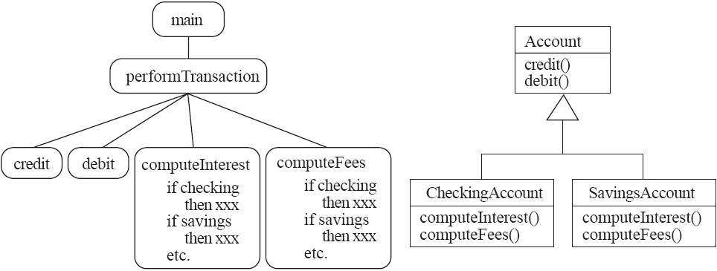
A View of the Two paradigms
The essential difference between the object-oriented
and procedural paradigms. In the procedural paradigm (shown on the left), the
code is organized into procedures that each manipulate different types of data.
In the object-oriented paradigm (shown on the right), the code is organized into
classes that each contain procedures for manipulating instances of that class
alone.
Chapter 2: Review of Object Orientation

Slide 10
Concepts that deﬁne object orientation
To be called object oriented, a language needs to have the following features:
Classes. The programmer must be able to organize the code into classes, each of which describes the structure and function of a set of objects.
Inheritance. There has to be a mechanism to organize these classes into inheritance hierarchies, where features inherit from superclasses to subclasses.
Chapter 2: Review of Object Orientation

Slide 11
Concepts that deﬁne object orientation
Polymorphism. There has to be a mechanism by which several methods, in related classes, can have the same name and implement the same abstract operation.
There must consequently be a dynamic binding mechanism that allows the choice of which method to run to be made during execution of the program.
Encapsulation. A class acts as a container to hold its features (variables and methods) and defines an interface that allows only some of them to be seen from outside.
Chapter 2: Review of Object Orientation

Slide 12
2.2 Classes and Objects
Classes and objects are the aspects of object orientation.
Object
  A chunk of structured data in a running software system.
  It can represent anything with which you can associate properties and behavior.
  Has properties
    Represent its state
  Has behavior
    How it acts and reacts
Chapter 2: Review of Object Orientation

Slide 13
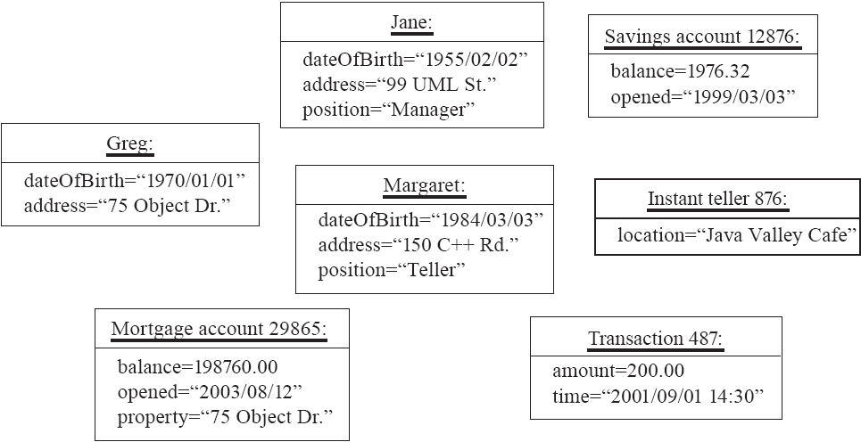
Objects
Some of the objects and their properties that might be important to a particular banking system.
Chapter 2: Review of Object Orientation

Slide 14
Objects
The following are some other examples of objects:
In a payroll program, there would be objects representing each individual employee.
In a university registration program, there would be objects representing each student, each course and each faculty member.
In a factory automation system, there might be objects representing each assembly line, each robot, each item being manufactured, and each type of product.
Chapter 2: Review of Object Orientation

Slide 15
Classes
A class:
  A unit of abstraction in an object oriented (OO) program
  A class is a software module that represents and defines a set of similar objects, its instances.
  All the objects with the same properties and behavior are instances of one class.
Chapter 2: Review of Object Orientation

Slide 16
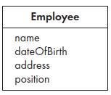
Classes
  The bank employees Jane and Margaret from previous figure can be represented as instances of a single class Employee.
  Class Employee declares that all its instances have a name, a dateOfBirth, an address and a position.
Chapter 2: Review of Object Orientation

Slide 17
Is Something a Class or an Instance?
  Something should be a class if it could have instances.
  Something should be an instance if it is clearly a single member of the set defined by a class.
Film
  Class; instances are individual films.
Reel of Film:
  Class; instances are physical reels
Film reel with serial number SW19876
  Instance of ReelOfFilm
Chapter 2: Review of Object Orientation

Slide 18
Naming classes
  Use capital letters
    E.g. BankAccount not bankAccount
  Use singular nouns
  If you want to give a class a name consisting of more than one word, then omit the spaces and capitalize the first letter of each word, for example: PartTimeEmployee.
  Try to keep your class names simple and descriptive. .
  Make sure the name has only one meaning.
Chapter 2: Review of Object Orientation

Slide 19
Exercise 1
  Identify all the classes you can think of that might be part of the following systems, and choose good names for them.
(a) A restaurant reservation system.
(b) A video rental store.
Chapter 2: Review of Object Orientation

Slide 20
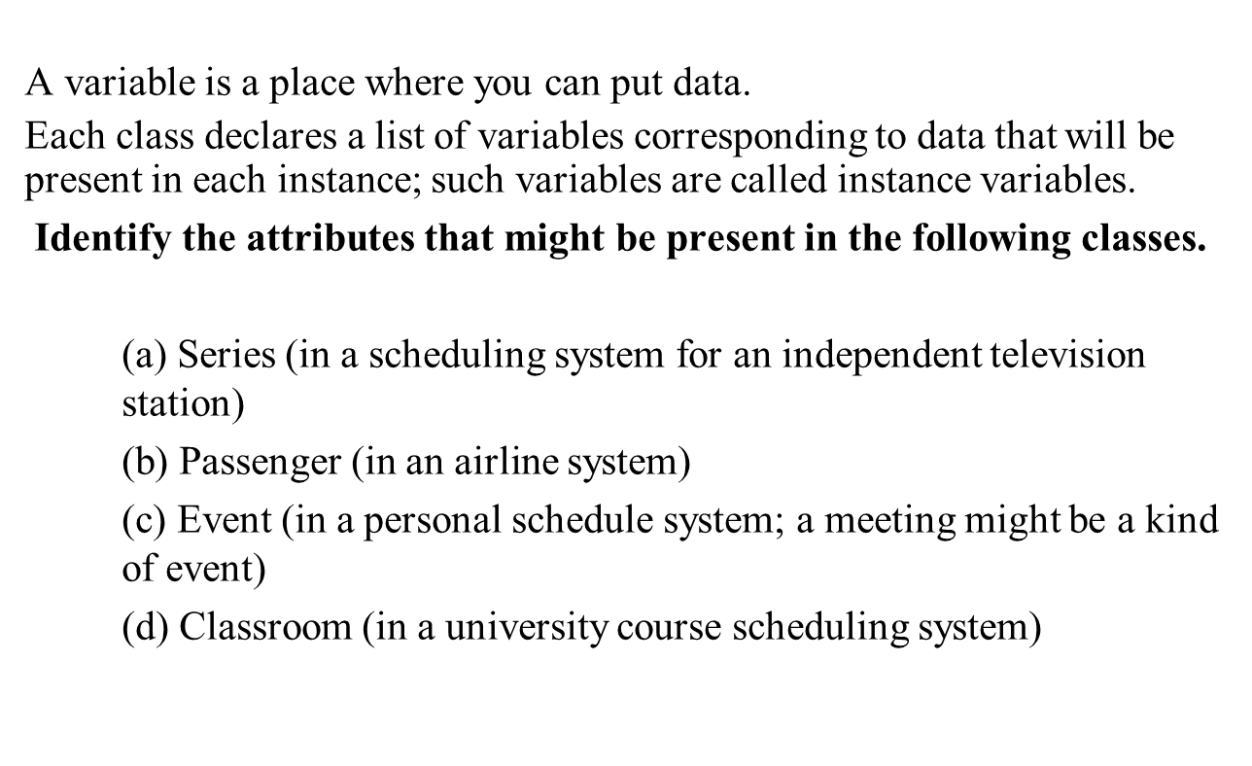
2.3 Variables
Chapter 2: Review of Object Orientation

Slide 21
Solution
a) name, description, (producer, distributer)
b) name, address, telephoneNumber, passportNumber
c) date, startTime, endTime, description
d) roomNumber, NumberOfSeats, seatingPattern
Chapter 2: Review of Object Orientation

Slide 22
Methods and Polymorphism
Method
  The word ‘method’ is used in object-oriented programs where the words ‘procedure’, ‘function’ or ‘routine’ might be used in other programs.
  A procedural abstraction used to implement the behaviour of a class.
Chapter 2: Review of Object Orientation

Slide 23
Polymorphism
A property of object oriented software by which an operation may be performed in different ways in different classes. Same object having different behaviour.
  Requires that there be multiple methods of the same name.
  Reduces the need for programmers to code many if-else or switch statements.
Chapter 2: Review of Object Orientation

Slide 24
Polymorphism
Types:
Static Polymorphism/Compile time
    A polymorphism which executes at the time of compilation is called compile time, static binding or static polymorphism.
    achieve through method overloading ( whenever a class contains more than one method with same name and different types of parameters.
    Due to the different sets of parameters, each method has a different signature(combination of method name and parameter list). That signature allows the compiler to identify which method to call and binds it to the method call. This approach is called static binding or static polymorphism.
Chapter 2: Review of Object Orientation

Slide 25
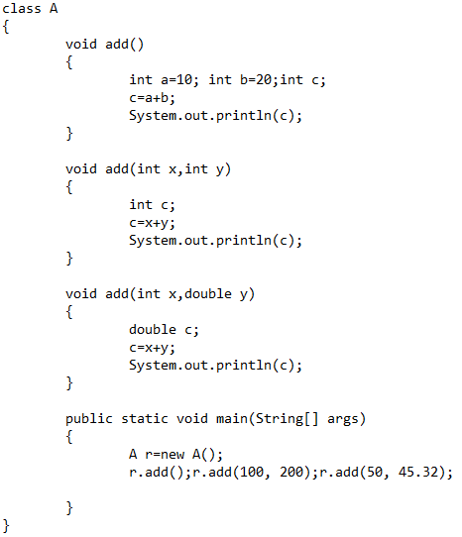
Example
Chapter 2: Review of Object Orientation

Slide 26
Polymorphism
Dynamic Polymorphism/ Runtime
    which exists at the execution of program.
    Method overriding.
    Within an inheritance hierarchy, a subclass can override a method of its superclass, enabling the developer of the subclass to customize or completely replace the behavior of that method.
    Method overriding is not performed without inheritance.
Chapter 2: Review of Object Orientation

Slide 27
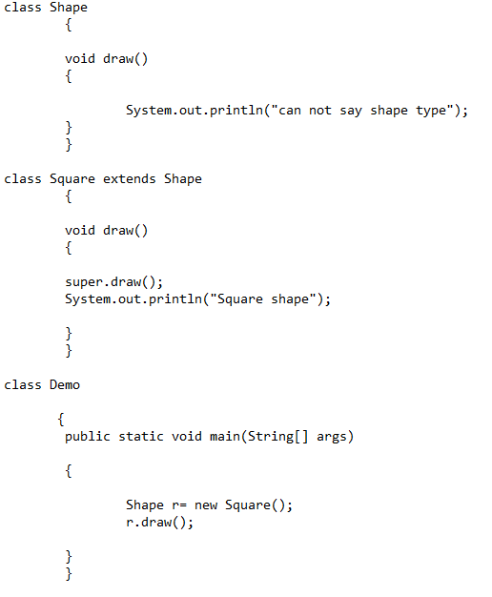
A reference variable of the super class can refer to a sub class object.
super keyword can be used to access methods of the parent class from the child class.
Chapter 2: Review of Object Orientation

Slide 28
Exercise
For each of the following sets of classes, find an appropriate superclass and the polymorphic operations that should be included in this superclass.
    (a) Square, Circle, Rectangle
    (b) Truck, Ambulance, Bus
Chapter 2: Review of Object Orientation

Slide 29
Solution
a) Superclass: Shape (or Shape2d). Operations: getArea, getPerimeterLength, getPoints .. etc
b) Superclass: Vehicle). Operations: getWeight, getNumberOfWheels, getColor
Chapter 2: Review of Object Orientation

Slide 30
Exercise 1
Create a class named 'PrintNumber' to print various numbers of different datatypes by creating different methods with the same name 'printn' having a parameter for each datatype.
Chapter 2: Review of Object Orientation

Slide 31
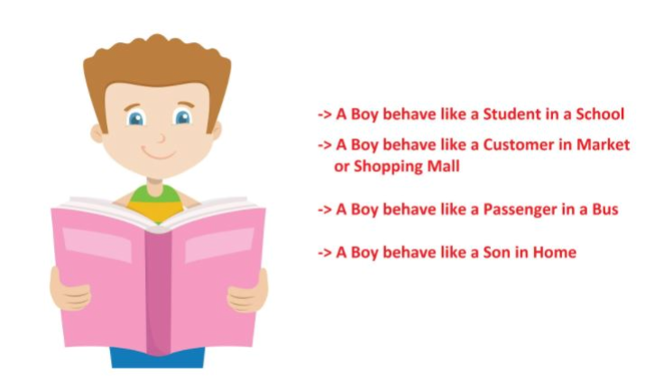
Exercise 2: Implement this in Lab also
Chapter 2: Review of Object Orientation

Slide 32
Exercise 3
A Packages Limited pays its employees on a weekly basis. The employees are of three types:
Salaried employees are paid a fixed weekly salary regardless of the number of hours worked.
Hourly employees are paid by the hour and receive overtime pay for all hours worked in excess of 40 hours.
Commission employees receive a base salary plus a percentage of their sales.
The company wants to implement a application that performs its payroll calculations.
Chapter 2: Review of Object Orientation

